Slide 1
Algorithmic Machine Learning Project
Regression Project: Capital Bikeshare Dataset
Team D:
Ashay Shah
Vaibhavi Mukadam
Xiaohan Zhang

Slide 2
Introduction
Data set is available at : http://archive.ics.uci.edu/ml/datasets/Bike+Sharing+Dataset. Date Donated -2013-12-20
This dataset was provided by Hadi Fanaee Tork using data from Capital Bikeshare.
Bike sharing systems are a new generation of traditional bike rentals where the whole process from membership, rental and return back has become automatic. Through these systems, users are able to easily rent a bike from a particular position and return back at another position.
Currently, there are about over 500 bike-sharing programs around the world which are composed of over 500000 bicycles.
Today, there exists great interest in these systems due to their important role in traffic, environmental and health issues.

Slide 3
Data Description
datetime - hourly date + timestamp
season - 1 = spring, 2 = summer, 3 = fall, 4 = winter
holiday - whether the day is considered a holiday
workingday - whether the day is neither a weekend nor holiday
weather -
1: Clear, Few clouds, Partly cloudy, Partly cloudy
2: Mist + Cloudy, Mist + Broken clouds, Mist + Few clouds, Mist
3: Light Snow, Light Rain + Thunderstorm + Scattered clouds, Light Rain + Scattered clouds
4: Heavy Rain + Ice Pallets + Thunderstorm + Mist, Snow + Fog
temp - temperature in Celsius
atemp - "feels like" temperature in Celsius
humidity - relative humidity
windspeed - wind speed
casual - number of non-registered user rentals initiated
registered - number of registered user rentals initiated
count - number of total rentals

Slide 4
Goal of our project
The training set is comprised of the first 19 days of each month, while the test set is the 20th to the end of the month. We have to predict the total count of bikes rented during each hour covered by the test set, using only information available prior to the rental period.

Slide 5
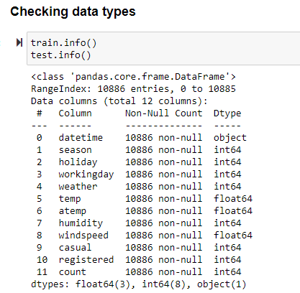
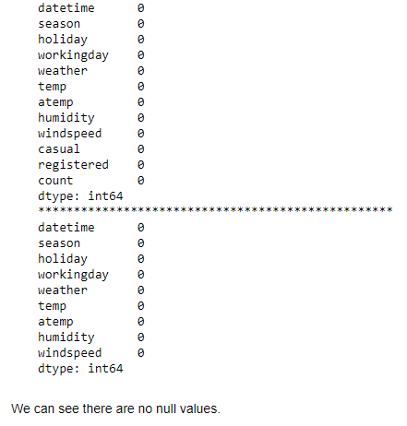
Observing the data
Checking for nulls:

Slide 6
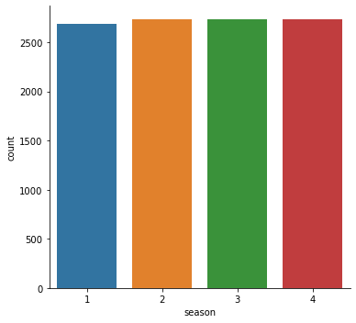
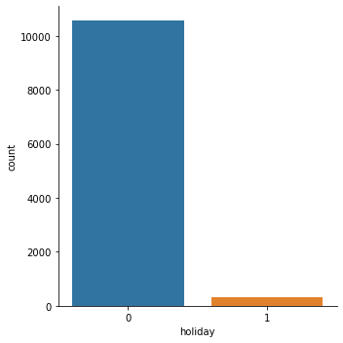
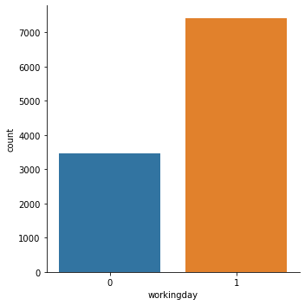
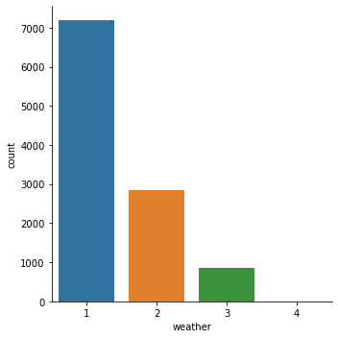
EDA for discrete features:

Slide 7
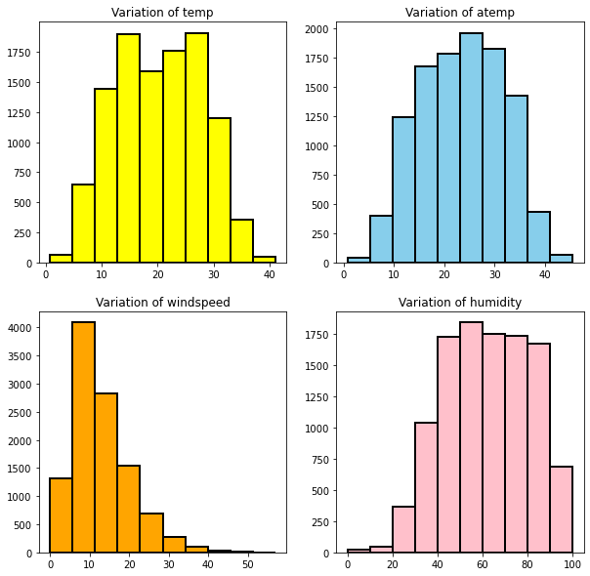
Histograms to see the variations of continuous features:

Slide 8
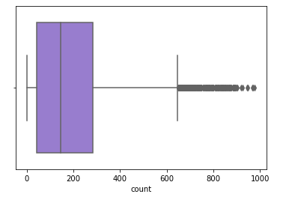
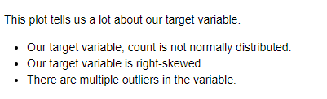
Plotting our target variable

Slide 9
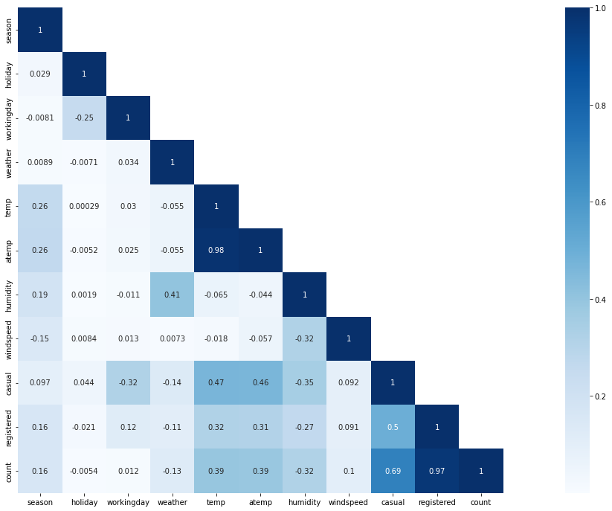
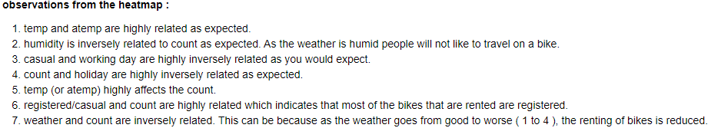
Correlation Matrix to show relation between all features

Slide 10
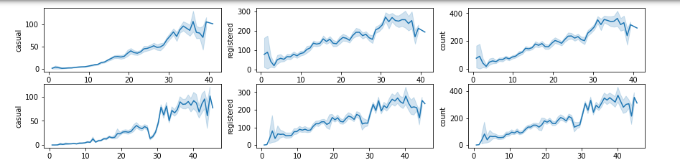
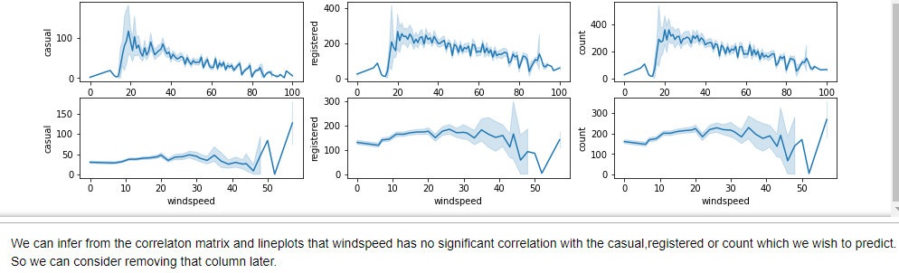
Line plots for our continuous features:

Slide 11
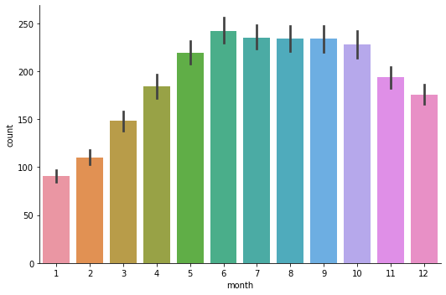
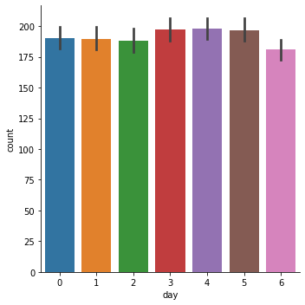
Understanding the Features after the split : Date time

Slide 12
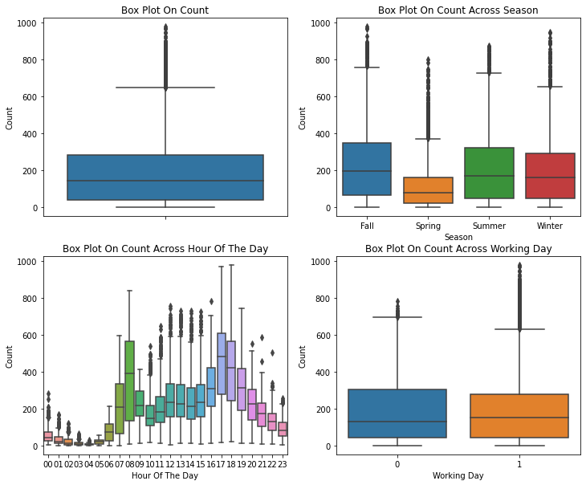

Slide 13
Model Analysis
Model analysis is based on-
Original data where only data time is divided into Month Day, hour, etc as datatime is not a supported data type.
New data table created after working on outliers and creating additional features. (like, the season variable)

Slide 14
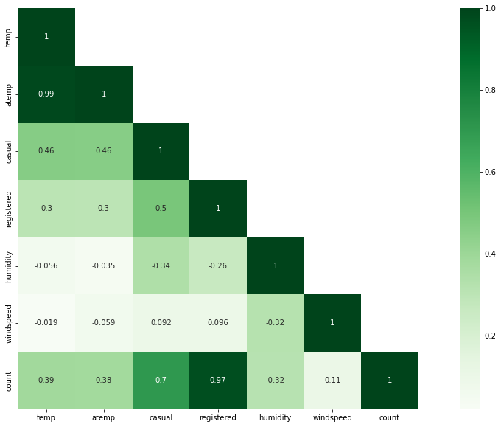
Correlation -

Slide 15
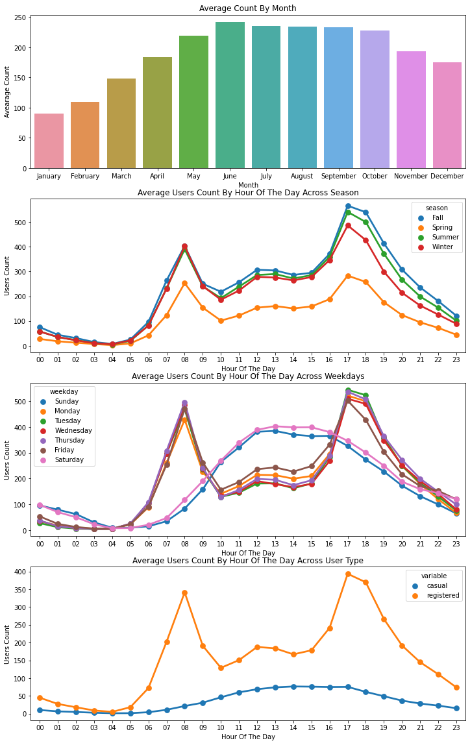
Visualizing Count Vs (Month,Season,Hour,Weekday,Usertype)

Slide 16
Accuracy Measure Table: Original data
 | Root Mean Square Error(RMSE) | R2 Score
Neural Network | 124.291 | 0.551
Neural Network: Change in parameter | 96.928 | 0.826
Random Forest | 47.402 | 0.934
Knn | 120.82675422385478 | 0.29912999892682257
Linear Regression | 145.97542283650546 | -0.6487026584664681
Lasso | 145.97351248716564 | -0.6492729054498181
Ridge | 145.9704302587459 | -0.6504185184160904

Slide 17
Accuracy Measure Table: Updated data
 | Root Mean Square Error(RMSE) | R2 Score
Neural Network +change in parameter | 87.836 | 0.883
Random Forest | 0.430 | 0.907
Knn | 0.5971887832979876 | 0.5971887832979876
Linear Regression | 1.0986252878556282 | -0.1985739562239146
Lasso | 1.0986250591652844 | -0.19857770001331088
Ridge | 1.098534901791631 | -0.19869383506406435
Dropping Casual and Registered features as its addition accounts to count.
Also, Season has been converted.

Slide 18
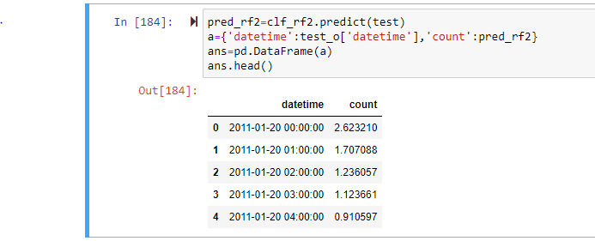
Best model :
Based on the R2 value, we the best model for predicting values of count variable is Random Forest.

Slide 19
THANK YOU

Slide 20
Thank You !

